Slide 1
The Factor Markets and Productivity
Labor Markets

Slide 2
Factors of Production
Land
Labor
Capital
Entrepreneurship

Slide 3
Labor Markets
Measures the supply and demand of labor
Supply of Labor = Workers
Demand for Labor = firms
Wage (W): the price of labor
Quantity of Labor (L)
W
S
W*
D
L
L*

Slide 4
Derived Demand
Demand that stems from the demand of another product
EX. Demand for chefs depends on how high or low the demand for eating out is.
During contractionary periods, people eat out less often, so there is less demand for chefs.
During expansionary periods, people eat out more often, so there is greater demand for chefs.
Illustrates the interconnectedness of markets

Slide 5
Total Product and Marginal Product
Total Product: The total number of units of a good produced by a firm
Marginal Product of Labor: The additional units of a product produced by the NEXT worker
L | TP | MP_{L}
1 | 6
2 | 18
3 | 26
4 | 32
5 | 35
L | TP | MP_{L}
1 | 6 | 6
2 | 18 | 12
3 | 26 | 8
4 | 32 | 6
5 | 35 | 3

Slide 6
Total and Marginal Revenue Product of Labor
Total Revenue Product of Labor: the total amount of revenue created from the production of goods
Calculated as TR = P*Q
Marginal Revenue Product of Labor: the additional revenue created by employing the NEXT worker
Calculated as MRP_{L} = MP_{L} * P

Slide 7
MRP_{L} = MP_{L} * P
MRP_{L} will increase if…
MP_{L} increases
P increases

Slide 8
How many workers will a firm hire?
Complete the exploration handout

Slide 9
How many workers will a firm hire?
Profit Maximization Rule: MRP_{L} = W
What will firms do if MRP_{L} > W?
What will firms do if MRP_{L} < W?

Slide 10
The Foot-Powered Bike
Labor | Bikes
0 | 0
1 | 5
2 | 9
3 | 12
4 | 14
5 | 15
6 | 15
P = $160 per bike
W = $480 per week

Slide 11
Sleeping Bag with Arms and Legs
Labor | Sleeping Bags
0 | 0
1 | 9
2 | 17
3 | 24
4 | 30
5 | 35
6 | 39
7 | 42
8 | 44
9 | 45
P = $60 per bike
W = $120 per day

Slide 12
Practice #3
Givens
P = $10
W = $50
How many workers will the profit-maximizing firm hire?
What will be their total profit?
Labor Input (L) | Total Product
0 | 0
1 | 9
2 | 17
3 | 22
4 | 25
5 | 26

Slide 13
Review: Utility Maximization
Next week is your April Vacation. You’ve decided to spend your free time going to the movies and go carting.
Movies cost $10 per ticket.
Go carting costs $5 for a 15 minutes race.
If you only have $25, what combination of movies and go carts maximizes your utility given the following table?
# Times Going | TU (Movies) | TU (Go Carts)
1 | 30 | 10
2 | 50 | 15
3 | 60 | 17
4 | 65 | 18

Slide 14
Utility Maximization
# Times Going | Marginal Utility (Movies) |  | Marginal Utility (Go Carts)
1 | 30 |  | 10
2 | 20 |  | 5
3 | 10 |  | 2
4 | 5 |  | 1
If you only have $25, what combination of movies and go carts maximizes your utility?

Slide 15
Least-Cost Rule (Cost Minimization)
A producer of gadgets pays $5 for each hour of labor and $10 for each hour of capital employed. The table below describes the total products of each at various levels of employment. Told that you must produce Q = 360 gadgets, find the least-cost combination of labor and capital.
# of L Employed | TP Labor | # of K Employed | TP Capital
1 | 50 | 1 | 100
2 | 90 | 2 | 190
3 | 120 | 3 | 270
4 | 140 | 4 | 330
5 | 150 | 5 | 375
6 | 155 | 6 | 405
Notes:
Steps to Solve:
Determine all the times when MPL/PL = MPK/PK
Determine which combination results in the required output (Q=360)
The best way to produce 360 gadgets is to hire two units of labor and three units of capital at a total cost of TC = $5*2 + $10*3 = $40.

Slide 16
Least Cost Rule
Two Ways to Phrase the Question:
You can produce Q* units of output, now find the least-cost way of doing so.
You can only spend $TC, find the highest level of output (Q*).
The only way to satisfy either of these constraints is to produce at a combination of two resources in which

Slide 17
How Firms Behave
Situation | Firm Will… | Which Causes… | And… | Until
 | ⬆L ⬇K | ⬇ | ⬆
 | ⬆K ⬇L | ⬇ | ⬆

Slide 18
Least-Cost Rule (Cost Minimization)
A producer of gadgets pays $5 for each hour of labor and $10 for each hour of capital employed. The table below describes the total products of each at various levels of employment. Told that you must produce Q = 360 gadgets, find the least-cost combination of labor and capital.
# of L Employed | TP Labor | # of K Employed | TP Capital
1 | 50 | 1 | 100
2 | 90 | 2 | 190
3 | 120 | 3 | 270
4 | 140 | 4 | 330
5 | 150 | 5 | 375
6 | 155 | 6 | 405
Notes:
Steps to Solve:
Determine all the times when MPL/PL = MPK/PK
Determine which combination results in the required output (Q=360)
The best way to produce 360 gadgets is to hire two units of labor and three units of capital at a total cost of TC = $5*2 + $10*3 = $40.

Slide 19
Now You Try!
#L | MPL | MPL/PL | #K | MPK | MPK/PK
1 | 150 | 15 | 1 | 70 | 14
2 | 100 | 10 | 2 | 60 | 12
3 | 80 | 8 | 3 | 50 | 10
4 | 40 | 4 | 4 | 40 | 8
5 | 30 | 3 | 5 | 30 | 6
6 | 10 | 1 | 6 | 20 | 4
A producer of gadgets pays $10 for each hour of labor and $5 for each hour of capital employed. The table below describes the total products of each at various levels of employment. Told that you must produce Q = 550 gadgets, find the least-cost combination of labor and capital.
# of L Employed | TP Labor | # of K Employed | TP Capital
1 | 150 | 1 | 70
2 | 250 | 2 | 130
3 | 330 | 3 | 180
4 | 370 | 4 | 220
5 | 400 | 5 | 250
6 | 410 | 6 | 270

Slide 20
Characteristics of a PC Labor Market
Wage Takers: Can hire as much labor as they like at the given market price
W = MC_{F}
MRP_{L} = D_{F}

Slide 21
Supply of Labor and the Substitution and Income Effects
At low wages, the substitution effect > the income effect
At high wages, the substitution effect < the income effect
This explains why an individuals labor supply curve bends backwards
W
S
L

Slide 22
Supply of Labor and the Substitution and Income Effects
Substitution Effect
Income Effect
As wages increase, so does the OC of leisure
Workers begin to substitute more work hours for fewer leisure hours in order to consume the relatively cheaper consumption goods
As wages increase, so do real incomes
Workers begin to consume more leisure hours, which is a normal good

Slide 23
Demand and Supply of Labor
Demand for Labor
Supply of Labor
Companies demand labor to make products
A company’s demand for labor depends on the demand for its product (derived demand)
Workers supply labor to companies, thus making labor an input in the production of a good

Slide 24
Perfectly Competitive Labor Market
Characteristics
Many firms exist that require labor in the market, meaning companies must compete for labor.
Firms are wage TAKERS, meaning they provide the market wage to their employees.

Slide 25
Perfectly Competitive Labor Market
W
Market
W
Firm
S
W_{M}
MFC
D
MRP_{L}
L_{M}
L
L_{F}
L

Slide 26
Factors that Shift Supply and Demand
Supply
Demand
Adult Population
Preferences
Time in school and training
The price of the firm’s output
The prices of other factors of production
Technology

Slide 27
Now You Try!
Sketch a side-by-side graph of the labor market for the production of hamburgers.
Illustrate the effect on wage and quantity of labor hours when…
The price of hamburgers decreases
The price of ground beef, an input, increases
A large class of high school students graduate and go to college, assuming that the incoming class is smaller and that high school students are the primary source of workers at a hamburger joint.
Events 2 and 3 occur simultaneously.

Slide 28
Monopsony
A market situation in which there is only one buyer
In the labor market, this means one firm employs all labor
Has price setting power, meaning the firm can set wages
Workers are wage takers
Wage Searcher: to increase the number of workers it hires, it must increase its wages to all its employees
Therefore, MC > S, causing this market structure to be inefficient.

Slide 29
Example of Monopsony
The Reserve Clause in baseball players’ contracts meant they could only play for one team
This lack of competition meant teams could pay their players significantly less
After 1976 the clause was eliminated and players were allowed to negotiate with other teams, giving players more wage setting power. This caused players’ salaries to soar.

Slide 30
Monopsony Graph
W
MC
S
D = MRP_{L}
L

Slide 31
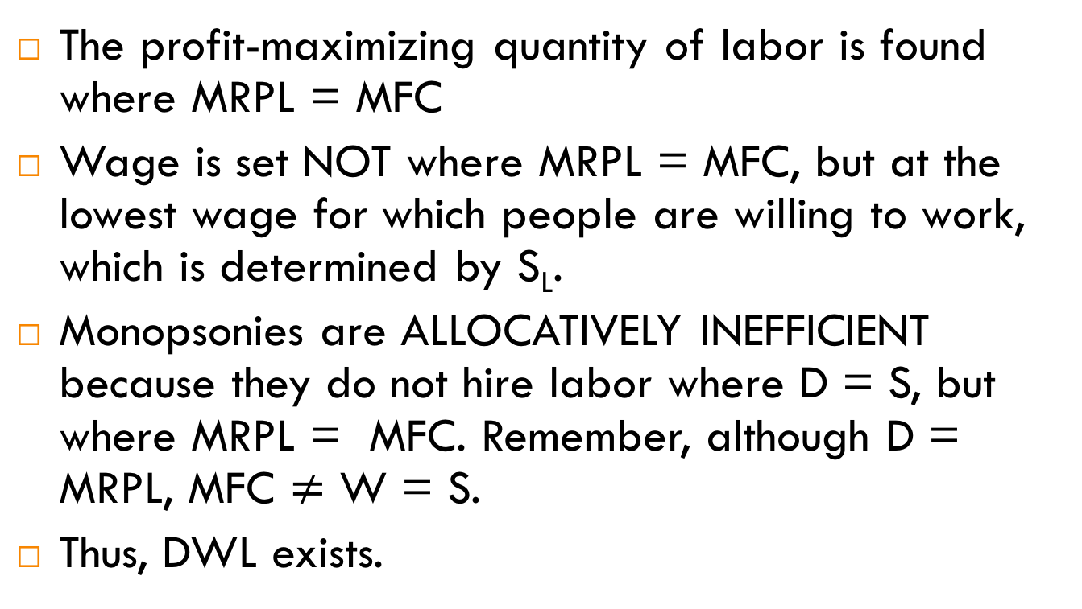
Monopsony Graph Details
The profit-maximizing quantity of labor is found where MRPL = MFC
Wage is set NOT where MRPL = MFC, but at the lowest wage for which people are willing to work, which is determined by S_{L}.
Monopsonies are ALLOCATIVELY INEFFICIENT because they do not hire labor where D = S, but where MRPL = MFC. Remember, although D = MRPL, MFC $≠$ W = S.
Thus, DWL exists.

Slide 32
Monopsony Graph
W
MC
S
MC
W$E$
W$π$
D = MRP_{L}
L$π$
L$E$
L

Slide 33
Warm-Up for Mock Exam
What have we learned this year?
Come up with a list of major topics that we’ve covered this year.
What graphs have you learned?
What formulas have you learned?
What rules have you learned?
What skills have you learned?
Break into groups. Each group will be given 2 topics to summarize. Include key ideas, definitions, formulas/rules, and skills. Create a web.
Explain how your topic relates to other topics in the course. We want to design a curricular web/road map.

