Slide 1
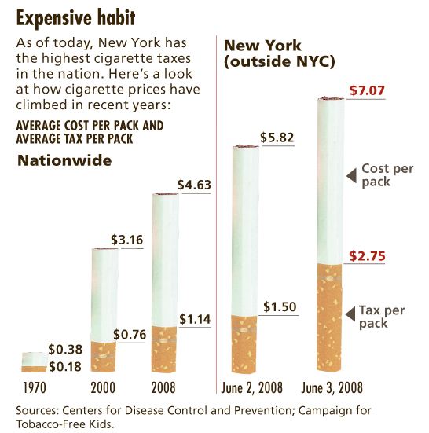
Taxes
Chapter 8

Slide 2
What is a tax?
A government regulation that raises the price of a good, service, or factor of production
Tax is collected as government revenue, which can be used to fund public goods like roads, parks, and schools
Meant to disincentivize production or consumption
Various Types
Tax on Products: Sales Tax v. Excise Tax
Tax on Factors of Production: Income Tax

Slide 3
Sales Tax v. Excise Tax
Sales Tax
Excise Tax
Tax that isn’t included in the stated price
Ex. Clothes, Food
Tax “on the consumer.”
Tax that IS included in the stated price
Ex. Gasoline, Alcohol, Cigarettes
Tax “on the producer”

Slide 4
Sales Tax
A sales tax is like a decrease in demand since the price to the consumer is a bit higher.
P
S
P*
D – T
D
Q
Q*

Slide 5
Does anyone benefit from a sales tax?
P
S
P*
D – T
D
Q
Q*

Slide 6
To find out, shade consumer and producer surplus
P
S
P*
D – T
D
Q
Q*

Slide 7
To find out, shade consumer and producer surplus
P
S
P_{D}
P*
P_{S}
D – T
D
Q
Q_{T}
Q*

Slide 8
What regions compose the CS, the PS, and the DWL?
P
S
13
1
P_{D}
2
3
4
P*
15
5
6
7
P_{S}
11
14
8
9
10
12
D – T
D
Q
Q_{T}
Q*
Notes:
CS: 1
PS: 8
Tax Revenue: 2+3+5+6
DWL: 4+7

Slide 9
So what happened to the area 2+3+5+6?
P
S
13
1
P_{D}
2
3
4
P*
15
5
6
7
P_{S}
11
14
8
9
10
12
D – T
D
Q
Q_{T}
Q*
Notes:
The difference between the price the consumer paid and the price received by the seller is the tax amount. Therefore, the region bounded by 2+3+5+6 represents the total tax revenue.

Slide 10
Tax Revenue
The government greatly benefits from taxes!
Per-Unit Tax: the amount of tax paid per unit of the good
Total Tax Revenue = Per-Unit Tax × Quantity Sold
EX. Cigarettes have a $2.75 tax per pack. If 100 packs are sold a day at the local corner store, the government will have earned
Tax Revenue = $2.75 × 100 = $275
This is represented by the shaded region on the previous slide

Slide 11
Excise Tax
An excise tax is like a decrease in supply since the advertised price is higher, which makes it appear as though the cost to produce is higher.
P
S+T
S
P*
D
Q
Q*

Slide 12
Does anyone benefit from an excise tax?
P
S+T
S
P*
D
Q
Q*

Slide 13
To find out, shade the consumer surplus, producer surplus, deadweight loss, and tax revenue
P
S+T
S
P*
D
Q
Q*

Slide 14
To find out, shade the consumer surplus, producer surplus, deadweight loss, and tax revenue
P
S+T
S
11
The government is the big winner!
1
12
P_{D}
2
3
4
P*
15
5
6
7
P_{S}
8
9
13
14
10
D
Q
Q_{T}
Q*
Notes:
CS = 1
PS = 8
DWL = 4+7
Tax Revenue = 2+3+5+6

Slide 15
Tax Incidence
Who bears the burden of a tax? The producer or the consumer?
This depends on elasticity and can be measured using consumer and producer surplus
Let’s take a look!
On the next few slides, sketch the given demand and supply curves given the elasticities
Shade consumer surplus, producer surplus, tax revenue, and deadweight loss
Examine who’s surplus was affected the most

Slide 16
E_{D}>1 and E_{S}>1
Sales Tax
Excise Tax
Is this tax efficient?

Slide 17
Who bears the tax burden?
Is this tax efficient?

Slide 18
E_{D}<1 and E_{S}<1
Sales Tax
Excise Tax
Is this tax efficient?

Slide 19
E_{D}>1 and E_{S}<1
Sales Tax
Excise Tax
Is this tax efficient?

Slide 20
E_{D}<1 and E_{S}>1
Sales Tax
Excise Tax
Is this tax efficient?

Slide 21
Perfectly Elastic…
Supply - Sales Tax
Demand - Excise Tax
Is this tax efficient?

Slide 22
Perfectly Inelastic…
Supply - Sales Tax
Demand - Excise Tax
Is this tax efficient?

Slide 23
So who should we tax?
Given that the tax incidence (or burden) is split based on elasticity of demand and supply, and that the government receives the same tax revenue regardless of who is taxed, it ultimately doesn’t matter to them whether the consumer or producer is taxed.
Taxation adds a disincentive to consume or produce. Therefore, the government/politicians tend to tax based on whether they want to try to control consumption or production.

Slide 24
Other Important Notes
Taxes create inefficiency within the economy. This is seen by the region of deadweight loss caused by decreased production or consumption. This inefficiency is PURPOSEFUL and is meant to disincentivize the consumption or production of products that the government deems bad.
Not all taxes are for products the government dislikes. For example, income isn’t bad. Houses aren’t bad. Some taxes are simply meant to raise revenue for the government.

Slide 25
Income Tax
A tax on your yearly wages
Income tax in America is taxed in intervals, meaning not all your income is taxed by the same percentage.
Three methods of taxation
Regressive
Proportional
Progressive

Slide 26
We aren’t done with taxes yet! We’ll return to taxes after we have looked at production costs. There are two other types of taxes we need to examine:
Lump-Sum
Per-Unit

