Slide 1
Unit 2
Demand, Supply, and Elasticity

Slide 2
Chair Auction
Only three students can use a desk for the entire rest of the year.
We will bid on the chair.
You don’t have to have the money on you today, but you cannot sit in the chair until you have paid for it, with the exception of today.

Slide 3
Chair Auction Bids

Slide 4
Quantity Demanded
The amount that people are willing and able to buy at a specific price
Example: # Students willing to bid on chair

Slide 5
The Law of Demand
Other things remaining the same, if the price of a good rises, the quantity demand of that good decreases; and if the price of a good falls, the quantity demanded of that good increases.
Quantity demanded and price share an inverse relationship.
Easily seen in the chair auction data

Slide 6
Demand (D)
The relationship between the quantity demanded (Q_{D}) and the price of a good when all other influences on buying plans remain the same.
Q_{D} ≠ D
Illustrated as the demand curve, which is almost exclusively downward sloping in nature (due to the law of demand).
Notes:
Demand is a list of quantities at different prices, while quantity demanded is a specific quantity at a given price. D is made up of Qd.

Slide 7
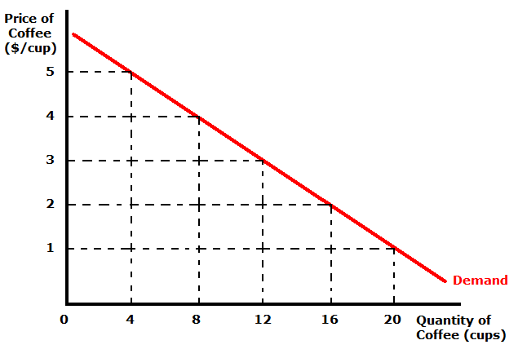
Reading the Demand Curve
If Q = 8, how much does coffee cost?
If Q = 16, how much does coffee cost?
If P = 3, how much coffee will people buy?
If P = 5, how much coffee will people buy?
What economic law is modeled here?

Slide 8
Individual Demand
Market Demand
Demand curve for individual person or firm
Demand curve for the entire market
Sum of all the individual demand curves

Slide 9
Changes in Demand
Prices of related goods
Expected future prices
Income
Expected future income and debt
Number of buyers
Preferences

Slide 10
Prices of Related Goods
Substitute Goods
Goods that are interchangeable. Consumer doesn’t necessarily value the goods any differently (the consumer is indifferent about which good they have)
Examples
Chocolate Cake or Cheese Cake
Beer or Cider
Yale or Harvard
Hotdogs or Hamburgers
Complementary Goods
Goods that you consume together
Examples
Peanut Butter AND Jelly
Salt AND Pepper
Hot Dogs AND Hot Dog Buns

Slide 11
Effects of Changes in Related Goods

Slide 12
Explain the effects of the following changes in price
P of teddy bears decreases
P of doll house decreases
P of doll increases
P of doll clothing increases
P of Barbie increases
P
Doll Market
D
Q

Slide 13
Explain the effects of the following
Christmas season is coming up and you expect toy prices to skyrocket
Justin Bieber is caught on camera declaring that he just can’t get enough of his new Baby doll. He doesn’t understand how he lived without one his whole life.
Unemployment is up 30%.
P
Doll Market
D
Q

Slide 14
Warm-Up
Sketch a graph of the demand for Halloween costumes.
At a given price, indicate on the graph what will happen to the demand and the quantity demanded if…
Halloween was a week ago
The Trick-or-Treating curfew is extended from 8PM to 10PM
The price of face paint increases

Slide 15
Quantity Supplied vs Supply
Q_{S} indicates the amount that firms/suppliers are willing and able to produce at a specific price.
Changes in price affect Q_{S} NOT S.
Supply shows the relationship between the quantity supplied (Q_{S}) and the price of a good when all other influences on selling plans remain the same.

Slide 16
Law of Supply
Other things remaining the same (ceteris paribus), if the price of a good increases, the quantity supplied will also increase. Alternatively, if the price of a good decreases, the quantity supplied will decrease.
Quantity supplied and price share a direct relationship. This results in an upward sloping Supply curve.

Slide 17
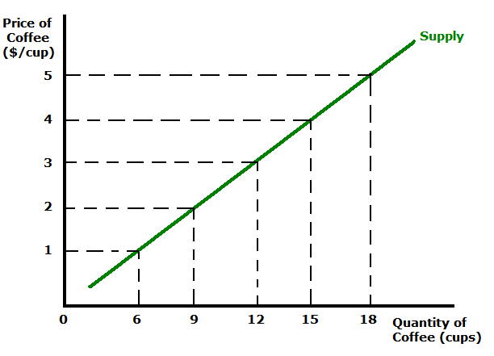
Reading the Supply Curve
If P = 1, Q_{S} = ?
If P = 4, Q_{s} = ?
If Q_{S} = 12, P = ?
If Q_{S} = 18, P = ?

Slide 18
Determinants of Supply Shifts

Slide 19
Market Equilibrium
Market equilibrium occurs where D = S. This indicates the price and quantity at which a product will be bought and sold.
D also known as MB, S also known as MC
If MB > MC, we increase consumption
If MB = MC, we are at equilibrium
IF MB < MC, we decrease consumption
At a price above equilibrium we have a surplus
At a price below equilibrium we have a shortage
D = S thus known as allocatively efficient

Slide 20
How do shifts in D and S affect market equilibrium?
Price and Quantity both affected

Slide 21
Homer vs the 18th Amendment
Watch the episode.
Where do you see economics?
Demand and supply?
How does the episode illustrate the law of demand and the law of supply?
Do we see productive efficiency? Allocative efficiency?
Comparative or Absolute Advantage?
Take notes and be prepared to discuss

