Slide 1
Chapter 11 Notes
Externalities and the Environment

Slide 2
Negative Externalities
Costs felt by individuals other than those producing or consuming a good.
Represented by a leftward shift in the marginal cost curve or the marginal benefit curve.
MSB = MB – negative externalities
MSC = MC + negative externalities
On the AP exam, negative externalities generally appear as a shift in the MC.

Slide 3
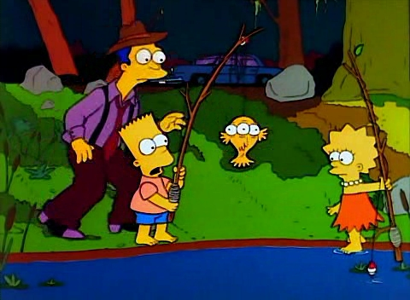
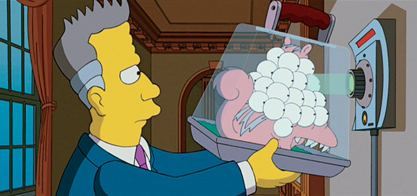
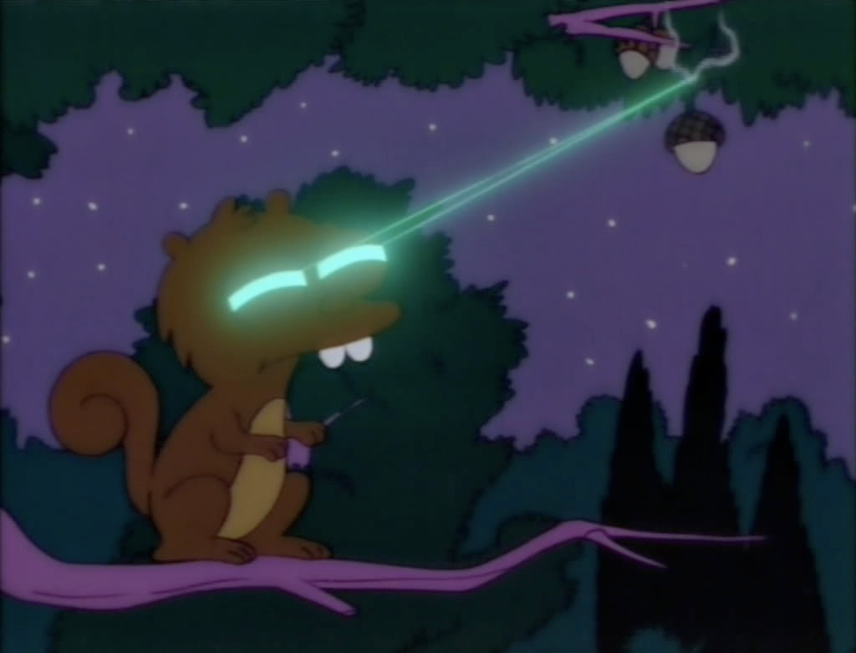
Pollution is a type of Negative Externality
Assume that a firm dumps toxic chemicals into a lake, which causes the fish to mutate and the local ecosystem to take on a life of its own.

Slide 4
Marginal Social Cost
In the existence of negative externalities, a marginal social cost (MSC) is imposed on society
Q_{S} < Q_{M} and P_{S} > P_{M}, which indicates that goods that produce negative externalities are OVERPRODUCED and sold at too low a price.
Because we produce at Q_{M}, a deadweight loss exists.
P
MSC
MC
P_{S}
DWL
Negative Externalities
P_{M}
MB
Q_{S}
Q_{M}
Q

Slide 5
Can the government overcome social inefficiency?
P
MC + T =
MSC
MC
Society tends to overproduce products that yield negative externalities
Therefore, we need to find a way to reduce production
Taxation (excise) disincentivizes production
Create a tax equal to the amount of the negative externalities
Our new equilibrium quantity, Q_{M2}, lies at the socially efficient quantity, Q_{S}, which eliminates the DWL
P_{S}
DWL
Externalities
= Tax
P_{M}
MB
Q_{S}
Q_{M}
Q
Q_{M2}

Slide 6
How much tax revenue does the government earn?
P
MC + T
MC
P_{S}
Tax Revenue = Tax * Q_{S}
Tax Revenue
P_{M}
Tax
MB
Q_{S}
Q_{M}
Q
Q_{M2}

Slide 7
The Coase Theorem
The proposition that IF property rights exist, only a small number of parties are involved, and transaction costs are low, THEN private transactions are efficient and the outcome is not affected by who is assigned the property right.

Slide 8
Coase Theorem Example
Your neighbor has a large tree that provides shade to your kids as they play in your backyard. One day, out of fear that the tree might fall on his roof, your neighbor decides to cut down the tree. You run out to stop your neighbor and plead for him to NOT cut down the tree.
What product market are we talking about?
What type of externality exists?
Will the market over or under-produce this product?
The solution? Does the government need to get involved?
Notes:
EX. The shade from a neighbor’s tree
To reach an agreement, both parties must weigh their marginal costs and marginal benefits.
What are the benefits to each party of the potential deal?
What are the costs to each party of the potential deal?
Cost to tree owner: cost to repair damage to house
Cost to shade beneficiary: cost to pay neighbor not to cut down tree

Slide 9
Common Resources
Rival and non-excludable goods
Leads to a great deal of inefficiency in terms of the usage of resources
This issue is known as the Tragedy of the Commons

Slide 10
Tragedy of the Commons
In the absence of incentives, common resources will be overused and depleted.
Results because no one considers the effects of his or her use of the resource on others.
Economic assumption: people look out for their best interest
Result: No need to worry about conservation. If I don’t consume the product, someone else will. So I might as well make a profit myself.
This issue is seen extensively in wildlife markets and is a focus of environmental economics.

Slide 11
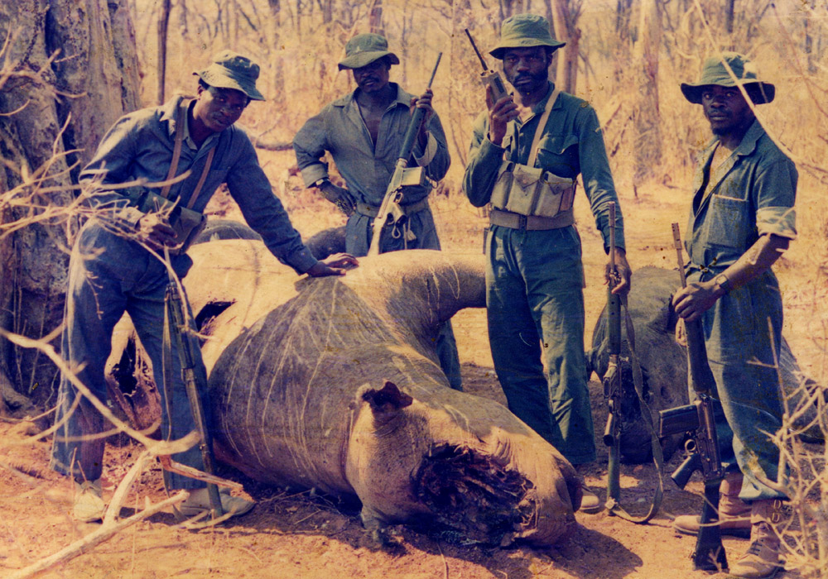
Think-Pair-Share: The Black Rhinoceros
Read pp64-69 from Chapter 2 of Naked Economics by Charles Wheelan
Identify what type of “good” a black rhinoceros is.
What was the free-rider problem as discussed with regards to conservation efforts?
How can you make a local population value conservation as much as the rest of society?
What is the dilemma that arises with the black rhinoceros as they are hunted toward extinction?
What economic concept does Charles Wheelan describe when he discusses the hunting of the black rhinoceros?
How can legalizing the sale of rhino horns actually diminish the incentive to poach the black rhino?
If supply-side economics can’t be controlled well-enough to save the rhino, what else can be tried? Explain

Slide 12
Supply-Side Solutions to overcome the Tragedy of the Commons
Property Rights
Incentivizes conservation for prosperity
Runs purely off the idea that businesses won’t put themselves out of business by squandering their entire supply of a limited resource
Quotas
An upper limit to the quantity of a good that may legally be produced in a specified period.
Set below allocative efficiency to be effective
Set equal to the socially efficient quantity to eliminate DWL
Notes:
Property Rights: Pay locals to NOT hunt the rhino. Similar to the tree example when discussing the Coase theorem

Slide 13
Quota
Quota
Negative externalities are overproduced, as seen by Q_{M} > Q_{S}.
One way to limit production of goods that produce negative externalities is to set a quota at the socially efficient quantity, Q_{S}.
This eliminates DWL
P
MSC
MC
P_{S}
DWL
P_{M}
MB
Q_{S}
Q_{M}
Q

Slide 14
Demand-Side Solutions to the Tragedy of the Commons
Decrease demand for products that are derived from endangered animals, plants, or environments
Educate the population

Slide 15
The End of the Line
Watch the documentary, “The End of the Line”
What is the prevailing problem in the fishing market?
What government regulations have been imposed to attempt to resolve the fishing problem?
Whose responsibility is it to preserve fish populations? Should we even care?

